Slide 1

Web Development Internship at
PS Motors
Basic Placeholder Webpage

Slide 2


Slide 3




The Stack
HTML
CSS
JAVASCRIPT
BOOTSTRAP

Slide 4
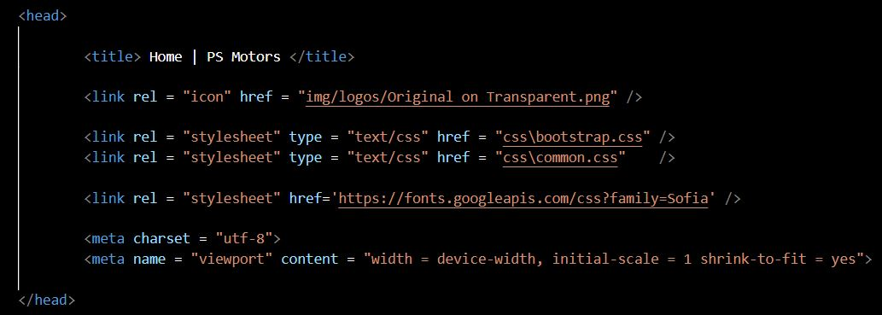
The Code - HTML

Slide 5
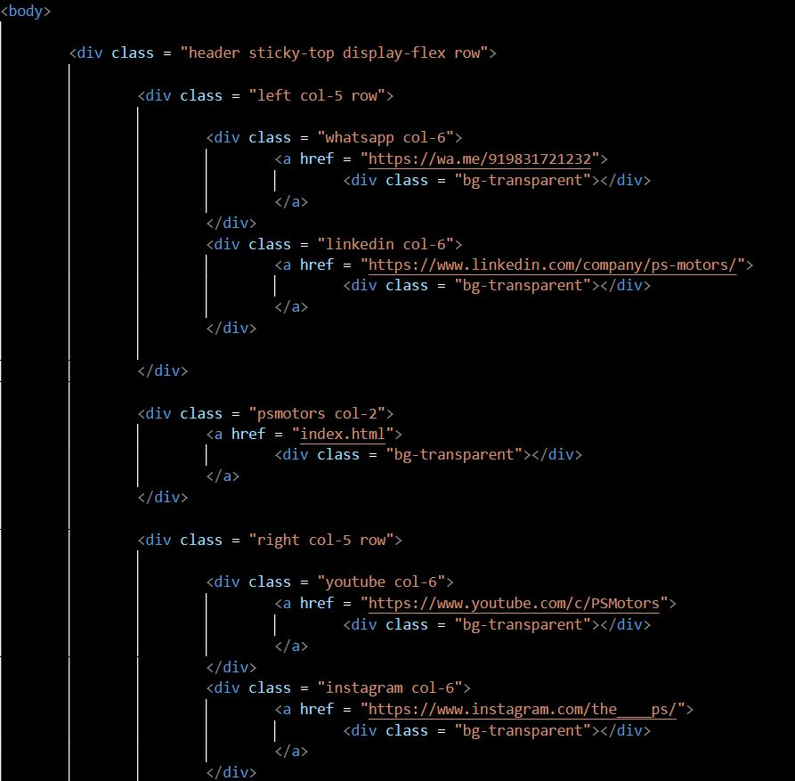

Slide 6
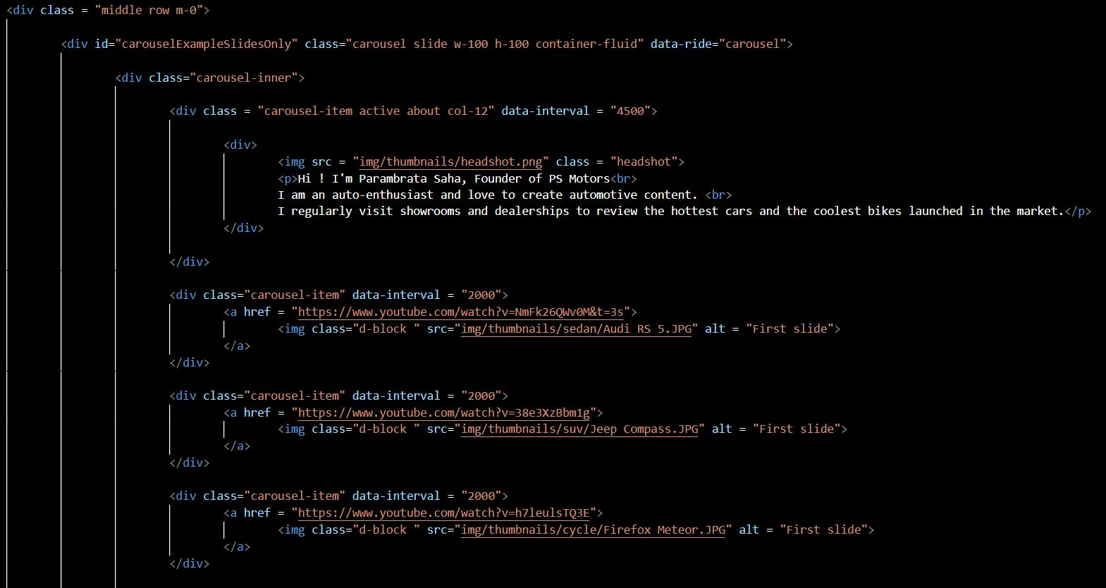

Slide 7
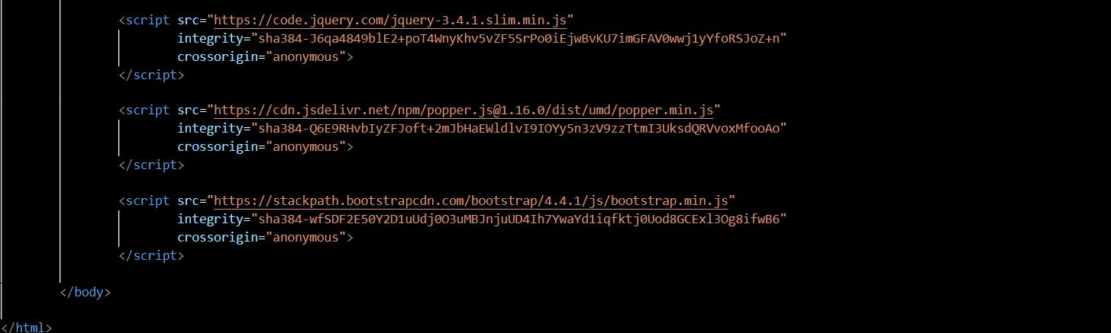

Slide 8
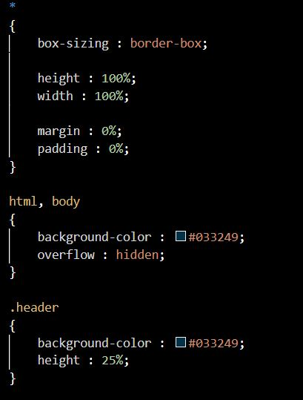
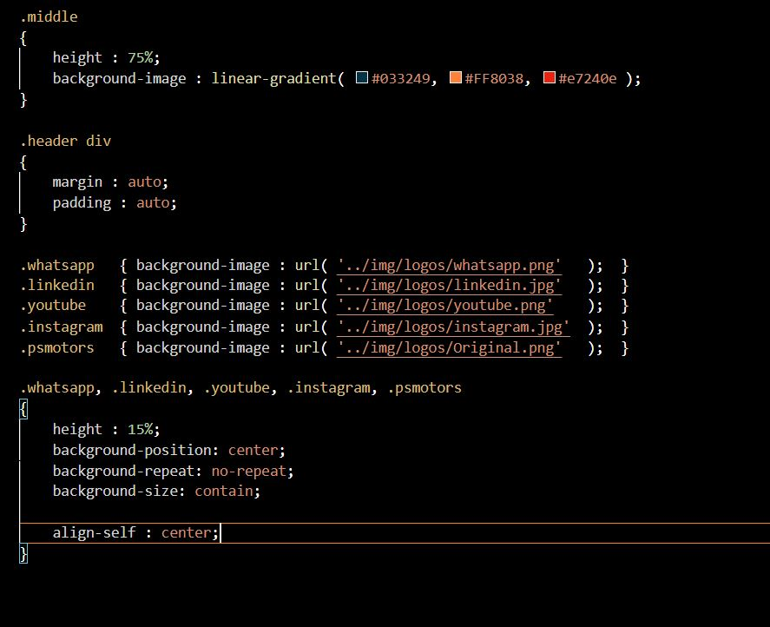
The Code - CSS

Slide 9
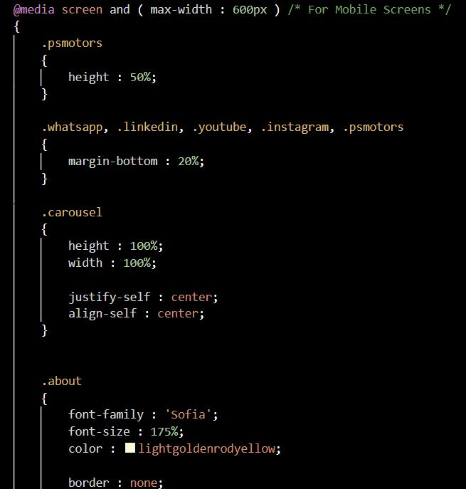
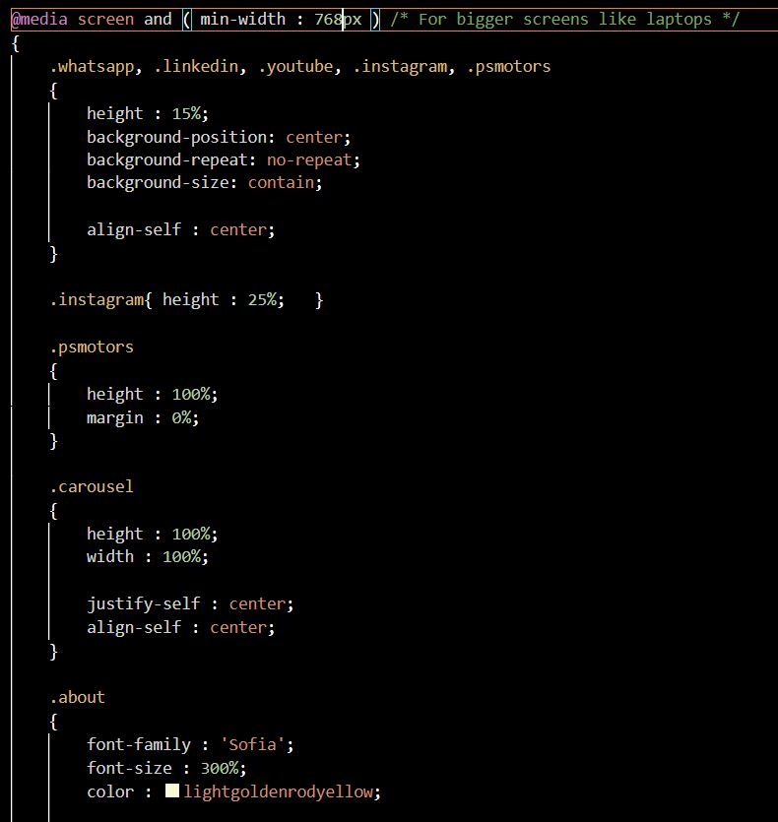

Slide 10
<h1> Thank You </h1>

